Slide 1

Automatic Loan Approval Prediction Rohit Gangadhar P Rifhath Aslam J
Roshan M
Shahul Hameed P T S
Yogeshkumar R
College/Team – Rajalakshmi Engineering College – Team Prathyegam

Slide 2
Business Need and Opportunity

Slide 3
Business Problem
One of the bank's main revenue sources has traditionally been loans . Before accepting a loan, banks have a lengthy review procedure that includes several steps to determine the risks involved.
A significant portion of the process depends on people, which occasionally leads to poor judgments.
Every time a process is carried out manually, there is a high probability of human error, which has an impact on the bank's revenue.
Additionally, processing applications manually requires more time and will be a time-consuming method.
Bank credit growth has witnessed significant fluctuations in the past one and a half decades.

Slide 4
Business Need and Opportunity
Bank credit growth has witnessed significant fluctuations in the past one and a half decades. Bank credit to industry increased by Rs 2.09 trillion in absolute terms in FY22 compared to a decline of about Rs 11,000 crore in FY21.
Gross credit of commercial banks expanded by 9.6 per cent in FY22 from 4.6 per cent in FY21. In absolute terms, banks lent Rs 10.43 trillion in FY22, up from Rs 5.39 trillion in FY21.
In a separate study, the rating agency CRISIL predicted that strong economic development and government budget assistance will increase bank lending growth by 200–300 basis points to 11–12% in FY23.
As CRISIL predicted that there will be increase bank lending amount Automating the process of loan approval may increase reliance on data by reducing human interaction in the process.

Slide 5
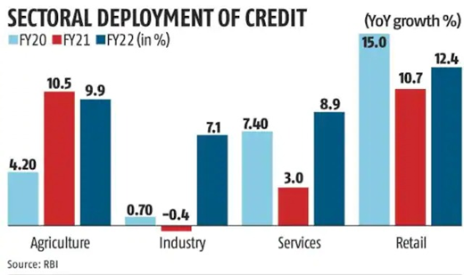
Business Need and Opportunity

Slide 6
Market Potential

Slide 7
Target Segment and Market Size
Potential users for our product include private banks and financial institutions, but given the product's adaptability, it may be utilised by any business that needs a loan approval.
Our product is created in such a way that it can adapt to any scale or use case, allowing us to market it to any business that requires loan clearance.
It is undeniably a trillion-dollar business; as was previously stated, banks alone lent their customers a whopping 10.43 trillion in FY22.

Slide 8
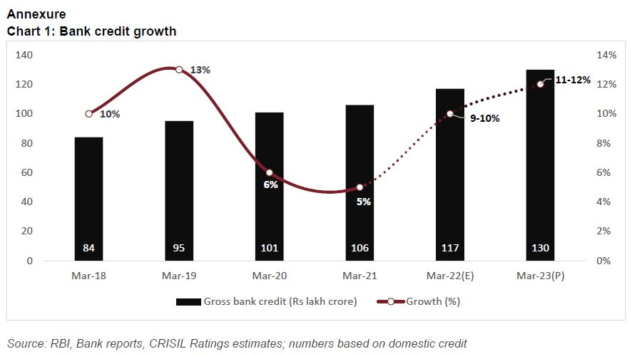
Target Segment and Market Size
The increase of bank credit has only been positive over the years, as seen by the graph below. Therefore, we may conclude that banks' ability to lend money has grown over time, which is an indication that the market is expanding steadily.

Slide 9
Solution Idea and more

Slide 10
Solution Idea
Automating the loan approval procedure is a suitable and necessary response to the market's demand.
However, our team's goal is to develop an accurate and user-friendly solution rather than merely automate the procedure. Additionally, our product is very versatile in a way that it can customize itself to every user needs.
In order to construct their own loan type, users first upload their dataset and may then design their own loan type based on their needs. Users must first create their own number of loan type according to their need.
once a loan type has been developed then user may immediately access the form where they can enter their data and run the software to determine if the applicant's loan is approved or not.
The user can also visualize the data using an extra feature moreover, the user is given access to an user guide that might assist them in using the product effectively.

Slide 11
Algorithm
We have blended seven machine learning models to work as one in order to deliver accurate prediction for the user data.
The seven machine learning algorithms are, Random forest classifier, Adaboost classifier, Gradient boosting classifier, Bagging classifier, Svc, and extratree classifier and by using voting classifier on the ensemble model we get the prediction for the user input.
Our algorithm also uses dual cross validation which allows our algorithm to fine tune its hyperparameter according to the data need, to produce an accurate solution.

Slide 12
Building users own loan type
Our product does not stick only with single loan model for all the use cases but users can create and train their own model using their own dataset.
Our product can create any number of loan type according to the user need.
As we are aware, real-time data is full of error and noise, and this inaccuracy plays a significant part in deciding the model's accuracy.
In order to counter this, we have incorporated data cleaning and feature selection into our model.
The system creates a dynamic form according to the user input using which the user can predict the loan status.

Slide 13
Visualization
Whenever the user uses his own dataset it is very important for the user to analyze the dataset.
The best way to analyze the dataset is to visualize it and visualizing the dataset also helps the users to interpret the complicated data in order to visualize the dataset instantly we have used JavaScript to project the all possible bar graphs with all the features provided in the dataset .
In addition to that user can select a particular feature and observe how the connected features change correspondingly and a sample of the dataset is also projected so users can refer it.

Slide 14
Scalability
Taking about A-LAP , A-LAP is designed to serve a broad range of customers, regardless of the scale of their needs.
We evaluated our software with data sets ranging in size from small samples to datasets with two million occurrences.
Additionally, we were able to visualize the dataset, and we obtained an average accuracy rate of 86% across the various datasets.
Users can also modify the product by adding any number of models and using them according to their needs, so we can assure that our product A-LAP is scalable both in data size and feature according to the user needs.

Slide 15
Usability
A-LAP being an customizable and scalable product it is very important that it is user friendly so in order to make it easier to use we have added a detailed user guide which the user can refer to .
The user guide is descriptive and accessible from every page in this product . In addition to that the design team also ensured that the UI is user friendly and intuitive in a way that a user should be able to learn to carry out simple tasks the first time they use our product.
Our product is designed in a way that users should be able to complete tasks quickly once they’ve grasped the basic design of the product

Slide 16
Cost
A-LAP is developed on open source software which are free to use.
To accomplish a robust version of A-LAP that can quickly process massive amounts of data, we must employ online GPUs, which will have an impact on the cost factor.
The price of online GPUs is closely associated with their computation power.

Slide 17
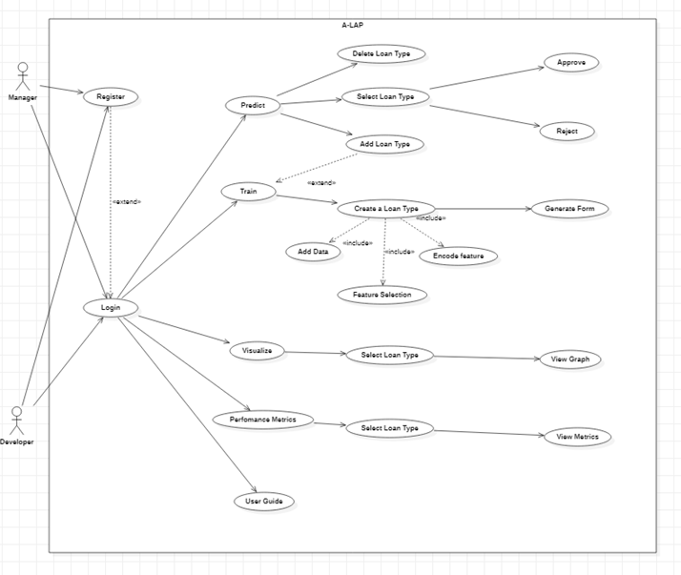
Use Case Diagram

Slide 18
Key Features
Accurate prediction.
Dynamic Form.
Visualization.
Performance Metrics.
Suggestions For Loan Amount.

Slide 19
Unique Benefits
The algorithm uses dual cross validation by which it can fine tune its hyperparameter to get more accurate solution and also rules out the problem of over fitting.
User can create their own type of loan .
User can preprocess ,encode and train their own model.
Better understanding of the training data using visualization.

Slide 20
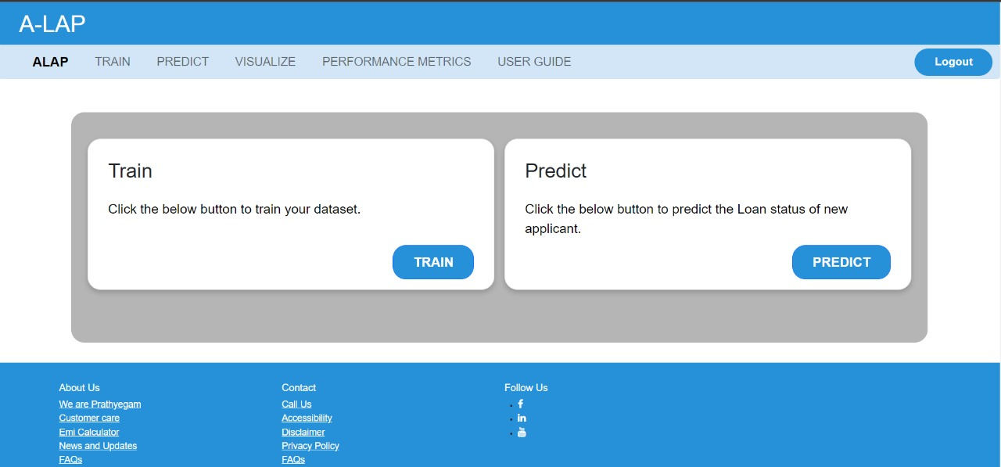
POC-Dashboard
Present a detailed solution demo, explaining the Proof of Concept (PoC)

Slide 21
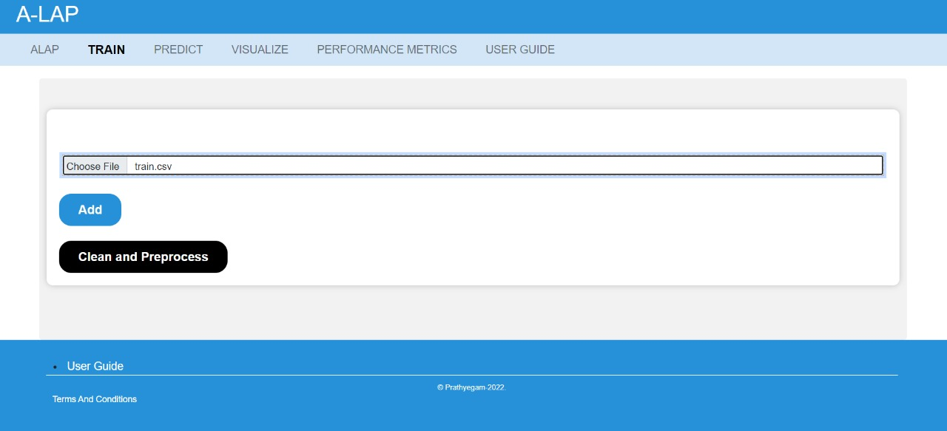
POC-Training Page

Slide 22
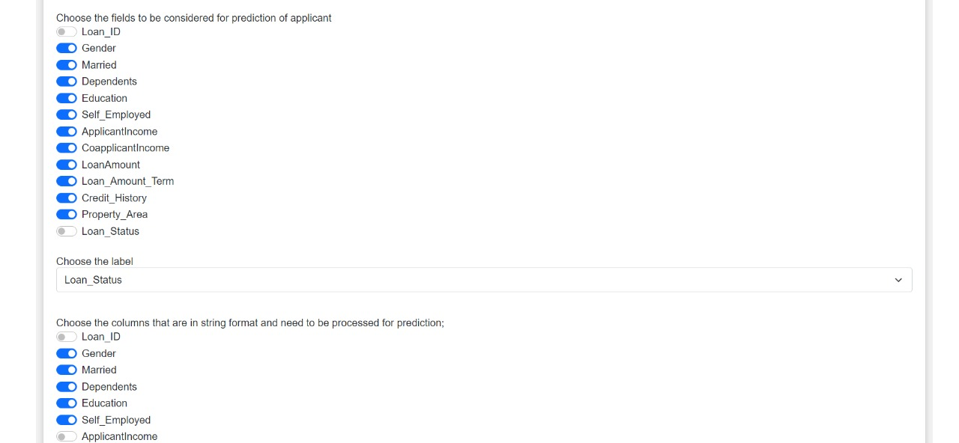
POC-Training Page

Slide 23
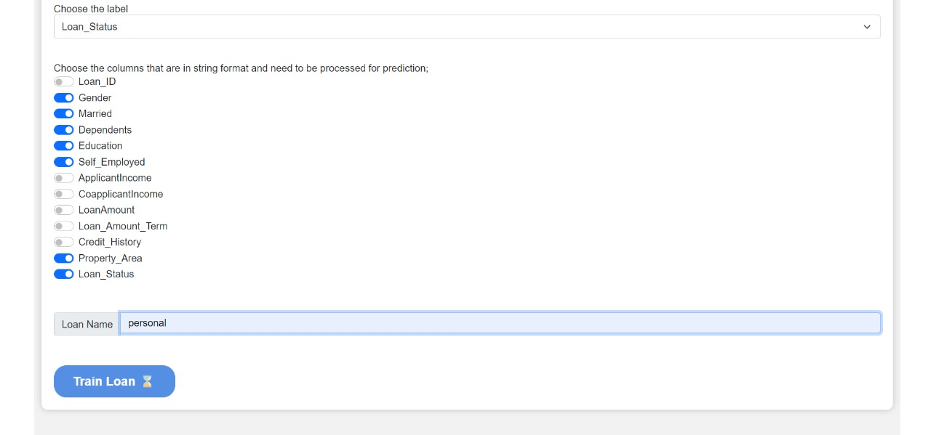
POC-Training Page

Slide 24
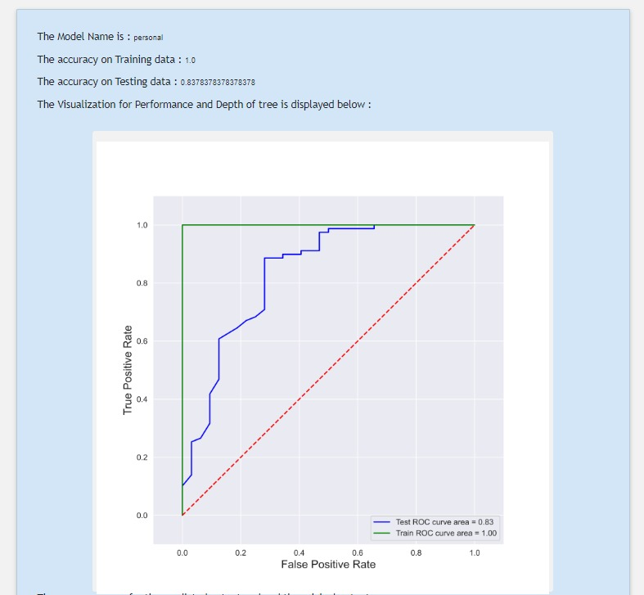
POC-Performance Metric

Slide 25
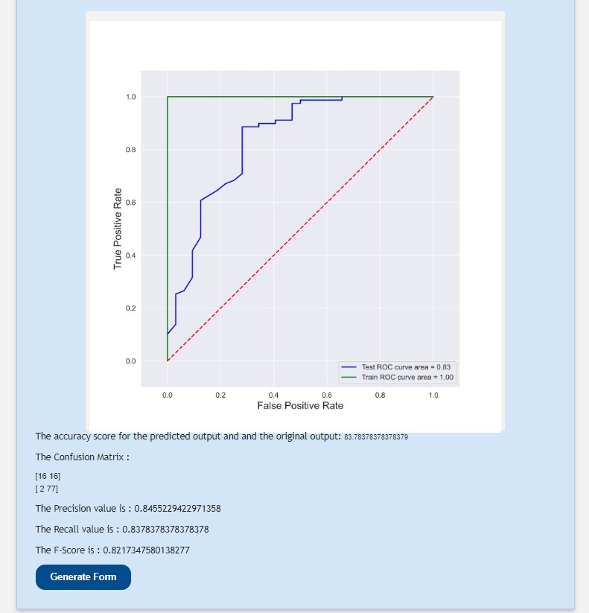
POC-Performance Metric

Slide 26
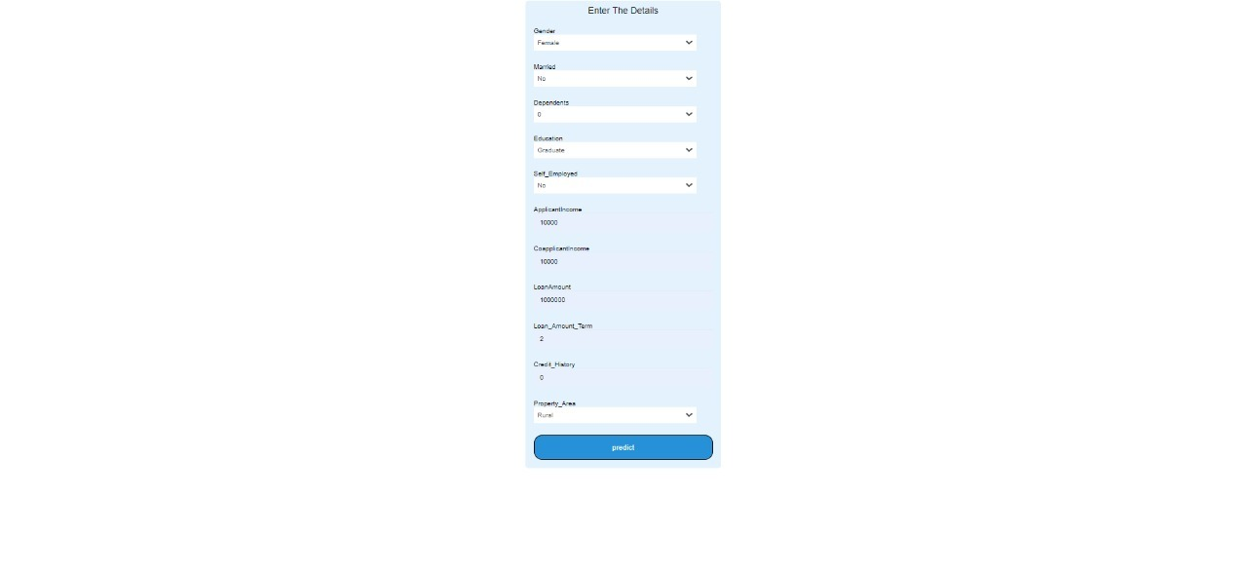
POC-Dynamic Form

Slide 27
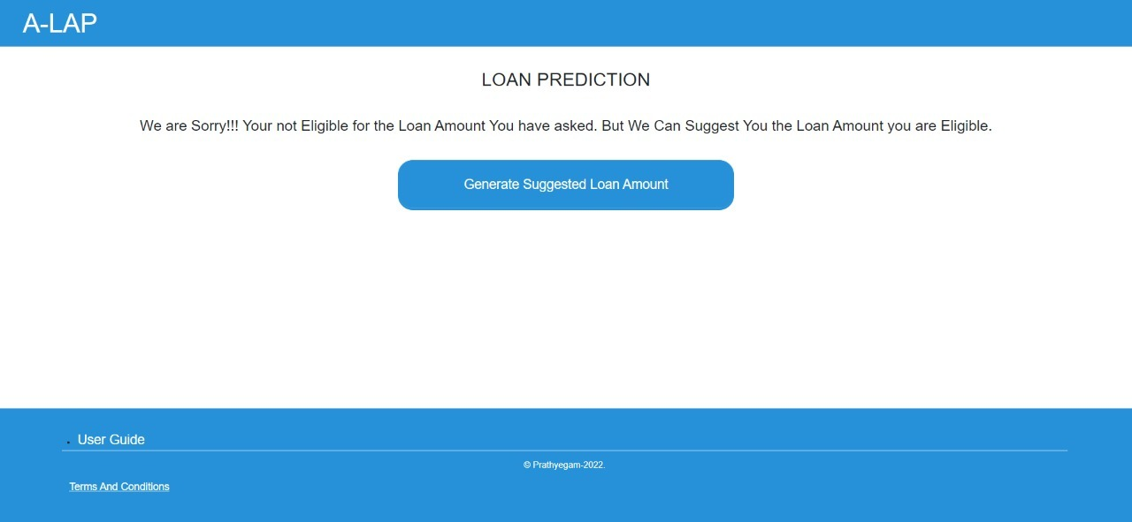
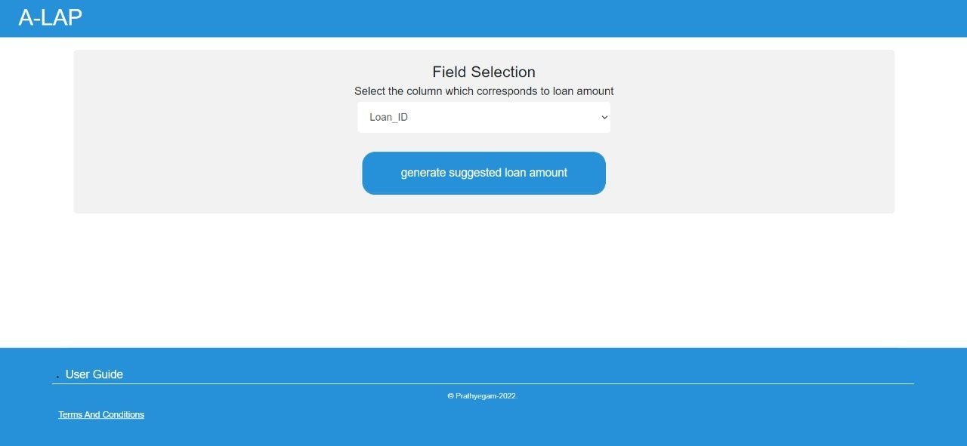
POC – Loan not Approved

Slide 28
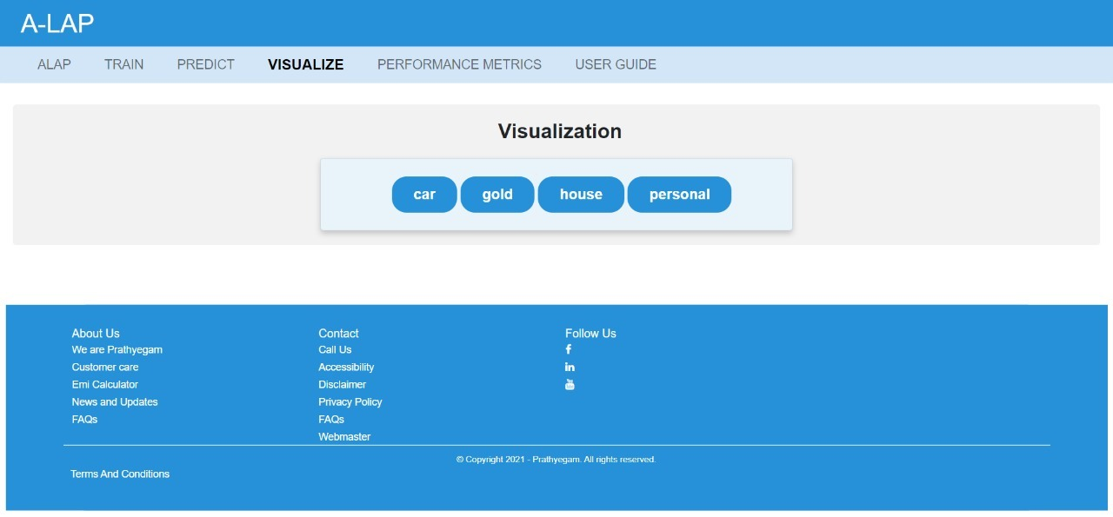
POC- Visualize

Slide 29
POC- Visualize

Slide 30
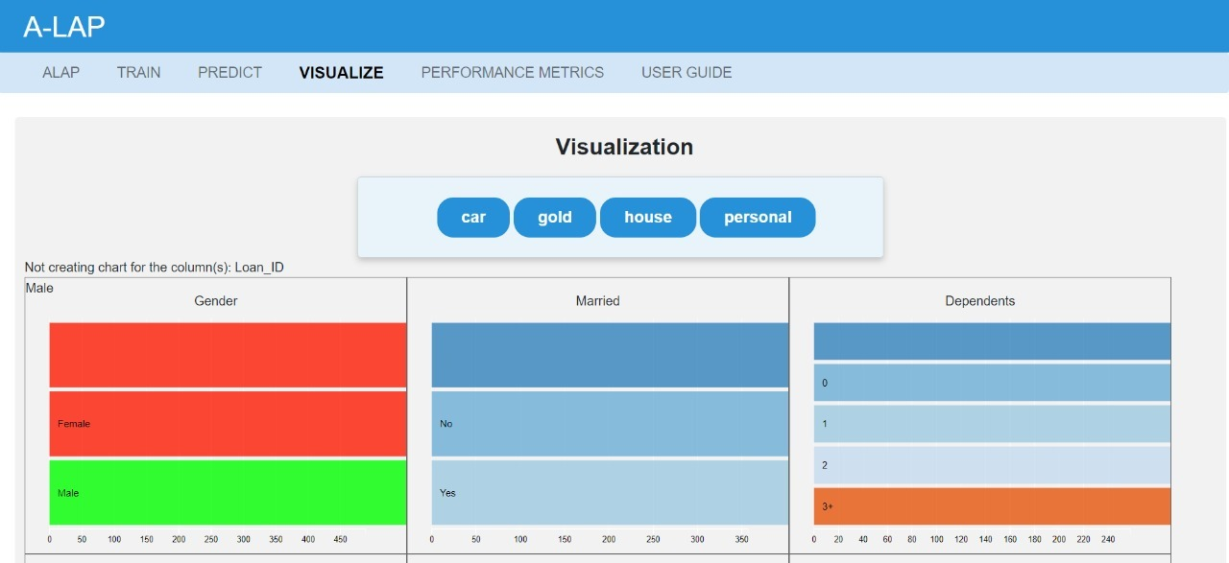
POC- Visualize

Slide 31
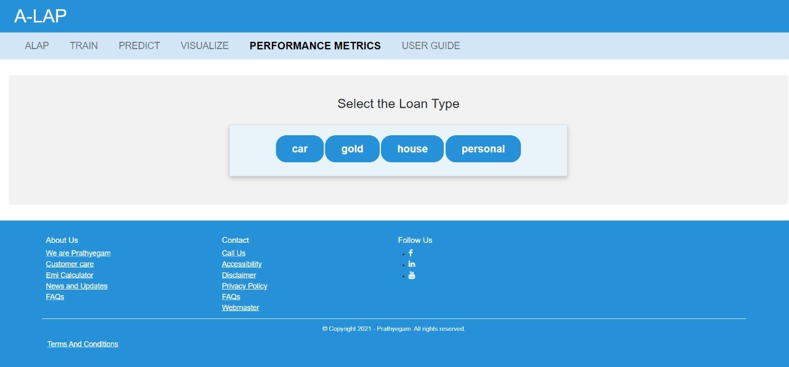
POC- Performance Metrics

Slide 32
POC-Performance Metrics

Slide 33
Future Readiness
Solution Roadmap
Cross-Industry application

Slide 34
Future Roadmap
Role Based Access Control (RBAC):
Role-based access control (RBAC) is a method of restricting network access based on the roles of individual users within an enterprise.
Employees can only access the information they require to do their duties thanks to RBAC, which also stops them from accessing information that doesn't concern them.
RBAC will increase our product’s security and usability.

Slide 35
Future Roadmap
Logging:
Application log contains information about events that have occurred within a software application along with the user name attached to it.
Logging can be used to track user activity inside an application and to solve security breaches.
Storing Loan Applicant Data:
Storing loan applicant data along with the prediction result can be used as a training data for the future models and they can also be used as activity tracker.

Slide 36
Future Roadmap
Accepting various input file types:
Currently our product can only read CSV file but developing a model which can read any type of data file .
Appending Datasets:
Appending the newly collected dataset to a old dataset which was used to create a model by which we increase the training data size using which our algorithm can find more pattern to accurately predict the applicant, By which we can improve our model over period.
Visualizing a Cluster of loan applicants using unsupervised learning methods.

Slide 37
Cross-Industry application
As said earlier users can create their own prediction model using a supervised dataset as an input to our product , by the same terms we can use our product for supervised prediction problems.
Every supervised prediction challenge that exists in the business can be met by A-LAP.

Slide 38
About the Team
Team Prathyegam has always been about brainstorming every idea and bringing that conceptualization into a working deployable model. We as a team have worked in great synchrony to complete these tasks even though being far away and connecting through online mode. The team works by micro managing the work flow and integrating the output in every sub final meetings making it easy to finish the desired product.

Slide 39
TEAM Members
Rifhath Aslam J: Specializes in researching the brainstormed ideas in order to bring them to reality and conceptualize them. He also works in the backend implementation with knowledge in flask and html linking and does the presentation and brochure works. Works perfectly according to the said instructions and gives the output as expected.
Roshan M: Works wholly on front end designing of UI and is an aspiring UX developer who wants learn and develop skills in this field. Works on any given time based on requirement and makes sure work is done for the day.
Shahul Hameed P T S: He works together with Rifhath on the backend working flow and has good knowledge in flask and Django. Makes sure he learns the concepts before the team finishes the concept design. Manages the team when I am not present and has handled many team meetings successfully without the required resources.
Yogeshkumar R: Teams up with Roshan and gets the UI designs done as soon as the source backend files and logic are submitted by the backend team. Also has basic knowledge of the backend logic which helps him design the UI faster.
And finally myself Rohit Gangadhar P, the Team lead, manages the whole work flow and implements the business and data logic of the backend. I specialize in machine learning algorithms and flask-html jinja correspondence to design the whole system. Once done, I micromanage the further tasks to the other 4 members based on their roles mentioned above and they submit the given tasks to complete the work flow.

Slide 40
Thank You
Notes:
Leading industry analysts and awards organizations have recognized Virtusa for our exceptional quality in digital engineering and transformational IT capabilities.
Highlights:
Virtusa's vLife™ platform in the Best New Product or Service of the Year - Health & Pharmaceuticals - Product category. vLife™ is a ready-to-use collaborative platform, built on a large clinical data lake that models disease progression or population-level risk categorization. By unifying data, AI, and IoT, Virtusa is helping the healthcare market address key pain points.

